Slide 2
Introduction to Antiretroviral Medicines, Mode of action and protocols
Notes:
2

Slide 3
At the end of this unit the learner should be able to:
Define ARVs and state their major indications
List the major classes of ARVs with examples
Describe the mechanism of action for each major class of ARVs
State standard dosages for first and second line regimens
Notes:
3

Slide 4
ARVs Are Medicines That;
Prevent the HIV from making copies of itself
Reduce the number of circulating HIV (Virological goal)
Ensure there’s reduced damage on the immune system leading to improved immune functioning &delay in onset of AIDS (Immunological goal)
Enhance quality of life & Reduce opportunistic infections (Therapeutic goal)
Reduce the impact of HIV transmission in the community (Epidemiological goal)
Notes:
4
Describe the goals of Antiretroviral therapy

Slide 5
Indications For ARVs
1. Antiretroviral therapy.
-Treatment of infected persons meeting treatment criteria.
2. Prevention of Mother-To-Child transmission. (PMTCT)
3. Post-exposure prophylaxis (PEP) and Post-rape care (PRC)
-Prevention of infection in exposed uninfected persons. e.g. needle stick injury, sexual assault
4. Pre-exposture prophylaxix (PrEP)
Notes:
5
Outline the major indications of ARVs

Slide 6
Classes Of ARVs
There are 5 major classes of ARVs:
Nucleoside Reverse Transcriptase Inhibitors (NRTIs) and Nucleotide Reverse Transcriptase Inhibitors (NtRTIs)
Non-Nucleoside Reverse Transcriptase Inhibitors (NNRTIs)
Protease Inhibitors (PIs)
Entry inhibitors
Integrase strand transfer inhibitors (INSTI) or Integrase inhibitors
Notes:
6
List the major classes of Antiretroviral drugs (ARVs).
ARVs are used in combination: One drug regimen not recommended as this leads to the rapid development of resistance

Slide 7
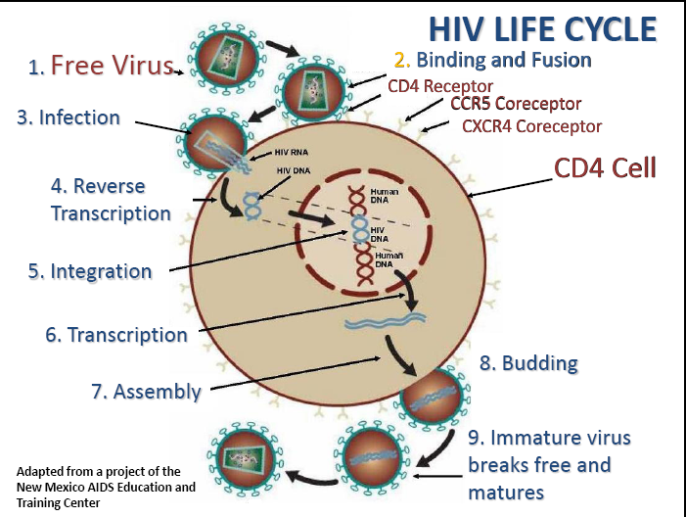
HIV LIFE CYCLE: Enzymes
Notes:
7
Activation of the host cells results in the transcription of viral DNA into messenger RNA (mRNA), which is then translated into viral proteins. The new viral RNA forms the genetic material of the next generation of viruses. The viral RNA and viral proteins assemble at the cell membrane into a new virus. Amongst the viral proteins is HIV protease, which is required to process other HIV proteins into their functional forms. The viral RNA and viral proteins assemble at the cell membrane into a new virus. Following assembly at the cell surface, the virus then buds forth from the cell and is released to infect another cell. CD4 cells are destroyed in this process
Emphasis: Bring participants attention to 3 key steps of the HIV life cycle that help to explain the classes of ARVs and target sites of action
-Fusion (entry of the virus to the immune cell)
-Reverse transcription (RNA to DNA)
--assembly and budding)
-

Slide 8
1. Nucleoside/Nucleotide Reverse Transcriptase Inhibitors
Nucleosides (NRTIs) were the first effective class of anti-retroviral drugs to be developed.
They are 1st choice and backbone in HIV treatment.
Nucleotides differ in structure from Nucleosides but they act in the same way.
Notes:
8
Nucleoside Reverse Transcriptase inhibitors (NRTIs) inhibit reverse transcription of viral RNA into DNA by competitively blocking reverse trancriptase enzyme activity.
NRTIs are faulty versions of the building blocks of viral DNA. They are incorporated into viral DNA-incomplete DNA is formed
Trainer:
NRTIs and NtRTIs Get incorporated into the DNA of the virus and stop chain elongation during the process where RT enzyme is converting RNA to DNA
Nucleotides work in the same way as Nucleosides. They differ in structure and mechanism by which they are activated to the active drug.
Tenofovir disoproxil fumerate is a nucleotide analogue reverse transcriptase inhibitor (NtRTIs).
NtRTIs are active in their native form and thus may be active against HIV in a wide variety of infected cells. By contrast, the NRTIs only work in cells that have the machinery to activate the drug by a process called phosphorylation. Renal toxicity has been reported, therefore renal assessment is required prior to treatment initiation. TDF should be avoided in people with renal impairment. TDF should only be used in combination with drugs from other ARV classes and not with 2 other NRTIs as a triple nucleoside combination.
Emtricitabine: Nucleoside Reverse Transcriptase Inhibitor
Cannot use Lamivudine and Emtricitabine together
Cross Resistance
Truvada (Tenofovir+Emtricitabine)

Slide 9
Both NRTI and NtRTIs prevent elongation of the DNA chain that is made by the reverse transcriptase enzyme
They resemble the natural building blocks of the DNA and therefore competes for the active site of the enzyme (Reverse Transcriptase).

Slide 10
Examples Of NRTIs & NtRTIs Drugs
NRTIs & NtRTIs Drugs
GENERIC NAME | ADULT DOSAGE
Stavudine, d4T | 30mg twice daily
Lamivudine, 3TC | 150mg twice daily OR 300mg once daily
Zidovudine, AZT or ZDV | 300mg twice daily
Didanosine, ddI | 250mg/400mg daily
Abacavir, ABC | 300mg twice daily OR 600mg once daily
Tenofovir, TDF | 300mg once daily
Zalcitabine, ddC | 0.75mg three times daily
Emtricitabine, FTC | 200mg once daily
Notes:
10
Give examples of NRTIs and emphasize on the adult dosages used.
Dosing of Didanosine is weight dependent:
Didanosine <60kg is 125mg b.d. (250mg o.d), ≥60kg is 200mg b.d (400mg o.d)

Slide 11
2. Non Nucleoside Reverse Transcriptase Inhibitors (NNRTI)
They attach themselves to reverse transcriptase and prevent the enzyme from converting RNA to DNA.
NNRTI bind directly to the reverse transcriptase enzyme and causes a structural change that disrupts the formation of the active site and leads to impaired polymerization activity.
So far, there are 5 that have been approved
Notes:
Rilpivirine (approved in May 2011), a second generation NNRTI like etravirine, may be dosed once-a-day. It appears to have a much lower incidence of CNS side effects and skin rash than efavirenz. However, rilpivirine does not appear to work as well as efavirenz against baseline HIV RNA of >100,000 copies/mcL. Additionally rilpivirine must have an acid milieu in the stomach for absorption; therefore the concomitant use of proton pump inhibitors (PPIs) is contraindicated. Source: http://hivmanagement.org/nnrti.html
11

Slide 12
NNRTIs
Nevirapine | 200mg twice daily
Efavirenz | 600mg once daily
Etravirine | 200mg twice daily
Rulpivirine | 25 mg once daily
Delarvidine | 400mg three times daily

Slide 13
3. Protease Inhibitors
Prevent the break down of large viral proteins into smaller useful parts such as enzymes and building block proteins.
Enzymes and building block proteins are needed to make complete copies of the virus which can infect other cells.
Block the protease enzyme from allowing the assembly and release of viable particles of HIV from infected cells.
Notes:
13
Trainer should ask participants for examples of PIs.
Trainer should briefly explain the reason behind combining Lopinavir and ritonavir in one formulation.
Boosted PIs: Ritonavir is a potent inhibitor of Cytochrome P450 responsible for breakdown of other drugs including protease inhibitors.
When a small dose of Ritonavir is combined with another PI, there is a boosted effect of the other PI. Meaning a lower dose of the boosted PI can be used. This has helped reduce the number of pills a patient has to take or the frequency of dosing
Examples: Lopinavir 400mg/ritonavir 100mg bd
Indinavir 800mg/ritonavir 100mg bd
Saquinavir 1000mg/ritonavir 100mg bd
Protease inhibitors have been shown to be potent drugs in both naïve and salvage situations at both high VL and low CD4 counts (boosted PIs).
Atazanavir:PI
causes less changes in cholesterol and glucose levels
Darunavir:PI

Slide 14
Examples Of PIs
GENERIC NAME | ADULT DOSAGE
Indinavir, IDV 200mg | 800mg tds or [IDV 800mg bd+ RTV 100mg bd]
Nelfinavir, NFV 250mg | 1250mg twice daily
Lopinavir/ritonavir, LPV/r (Aluvia®) 200/50mg | 400/100mg twice daily
Ritonavir, RTV 100mg | 600mg bd [only to be used as a booster for other PIs at a low dosage]
Saquinavir, SQV (soft gelatin capsule-fortovase ®) 200mg | 1200mg tds or in combination with Ritonavir [SQV 1000mg bd + RTV 100mg bd]
Fosamprenavir f-APV 700mg | f-APV 1400mg od + RTV 200mg od OR f-APV 700mg bd+ RTV 100mg od
Atazanavir, ATV | 400mg od or ATV 300mg/RTV 200mg od
Notes:
14
Trainers should emphasis on participants knowing doses for the first 4 drugs (IDV< NFV and LPVr) and ritonavir booster dose
Give examples of PIs citing their standard dosages

Slide 15
4. Entry Inhibitors
Prevent HIV from entering healthy CD4 cells
Drugs marketed in this category
Enfuvirtide (Fusion Inhibitor)
Is provided as a powder to be reconstituted by the patient before subcutaneous injection
Very expensive. Used as salvage therapy
Maraviroc (CCR5 Antagonist) is administered as 300mg BD
Notes:
15
Enfuvirtide blocks the second step in the fusion pathway by binding to the HR1 region of glycoprotein 41 (gp41). This mechanism does not allow HR1 and HR2 to fold properly, thereby preventing the conformational change of gp41 required to complete the final step in the fusion process. http://emedicine.medscape.com/article/1533218-overview#aw2aab6b8
Maraviroc is a small molecule that selectively and reversibly binds the CCR5 coreceptor, blocking the V3 loop interaction (of GP 120) and inhibiting fusion of the cellular membranes. Maraviroc is active against HIV-1 CCR5 tropic viruses. It has no activity against CXCR4 tropic or dual/mixed tropic virus. http://emedicine.medscape.com/article/1533218-overview#aw2aab6b9

Slide 16
5. Integrase Inhibitors
Inhibit the integrase enzyme which is responsible for integration of the virus DNA into the host cell DNA
Examples
Raltegravir administered as 400mg BD
Elvitegravir
Dolutegravir (DTG)
Notes:
16
The trainer to confirm the availability of Integrase inhibitors

Slide 17
HIV LIFE CYCLE: Drug Target Sites (RECAP)
Notes:
17
Trainer:
Activation of the host cells results in the transcription of viral DNA into messenger RNA (mRNA), which is then translated into viral proteins. The new viral RNA forms the genetic material of the next generation of viruses. The viral RNA and viral proteins assemble at the cell membrane into a new virus. Amongst the viral proteins is HIV protease, which is required to process other HIV proteins into their functional forms. The viral RNA and viral proteins assemble at the cell membrane into a new virus. Following assembly at the cell surface, the virus then buds forth from the cell and is released to infect another cell. CD4 cells are destroyed in this process

Slide 18
All persons diagnosed with HIV should start treatment (The recommended ART).

Slide 19
ART
TDF + 3TC + DTG

Slide 20
NOTE
Currently there is a one month injectable ART;
Cabotegravir/rilpivirine (CAB/RPV)
Studies have shown that it works well also when given every two months

Slide 21
Available regimes

Slide 22
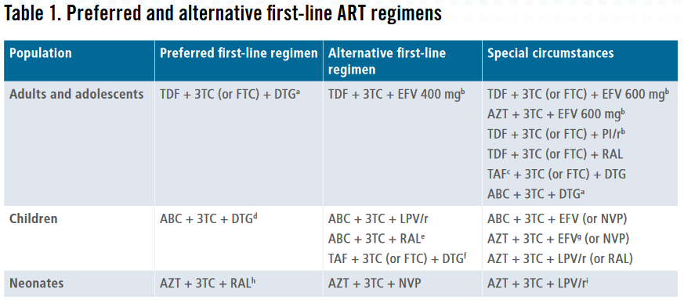

Slide 23
KEY for the above table
3TC: lamivudine; ABC: abacavir; AZT: zidovudine; DTG: dolutegravir; EFV: efavirenz; FTC: emtricitabine; LPV/r: lopinavir/ritonavir; NVP: nevirapine; PI/r: protease inhibitor boosted with ritonavir; RAL: raltegravir; TAF: tenofovir alafenamide; TDF: tenofovir disoproxil fumarate.
a) Effective contraception should be offered to adult women and adolescent girls of childbearing age or potential. DTG can be prescribed for adult women and adolescent girls of childbearing age or potential who wish to become pregnant or who are not otherwise using or accessing consistent and effective contraception if they have been fully informed of the potential increase in the risk of neural tube defects (at conception and until the end of the first trimester). If women identify pregnancy after the first trimester, DTG should be initiated or continued for the duration of the pregnancy (Box 2).

Slide 24
b) EFV-based ART should not be used in settings with national estimates of pretreatment resistance to EFV of 10% or higher. DTG-based ART is preferred, and if DTG is unavailable, a boosted PI-based regimen should be used. The choice of PI/r depends on programmatic characteristics.
c) TAF may be considered for people with established osteoporosis and /or impaired kidney function.
d) For age and weight groups with approved DTG dosing.
e) RAL should be used as an alternative regimen only if LPV/r solid formulations are not available.
f) For age and weight groups with approved TAF dosing.
g) EFV should not be used for children younger than three years of age.
h) Neonates starting ART with an RAL-based regimen should transition to an LPV/r solid formulation as soon as possible.
i) LPV/r syrup or granules can be used if starting after two weeks of age.

Slide 25
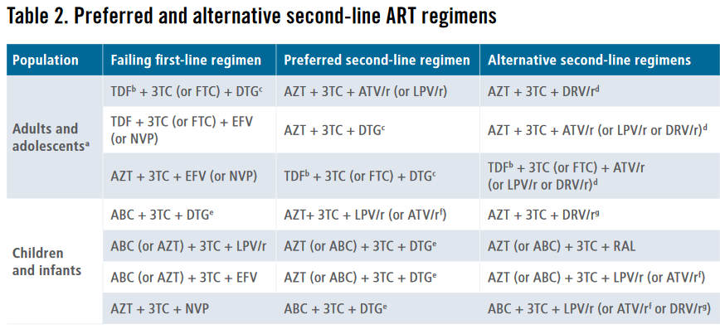

Slide 26
3TC: lamivudine; ABC: abacavir; ATV/r: atazanavir/ritonavir; AZT: zidovudine; DRV/r: darunavir/ritonavir; DTG: dolutegravir; EFV: efavirenz; FTC: emtricitabine; LPV/r: lopinavir/ritonavir; NVP: nevirapine; RAL: raltegravir; TDF: tenofovir disoproxil fumarate.
a) Sequencing if PIs are used in first-line ART: ATV/r (or LPV/r or DRV/r depending on programmatic considerations) + TDF + 3TC (or FTC) and then AZT + 3TC + DTG in second-line ART.
b) Effective contraception should be offered to adult women and adolescent girls of childbearing age or potential. DTG can be prescribed for adult women and adolescent girls of childbearing age or potential who wish to become pregnant or who are not otherwise using or accessing consistent and effective contraception if they have been fully informed of the potential increase in the risk of neural tube defects (at conception and until the end of the first trimester). If women identify pregnancy after the first trimester, DTG should be initiated or continued for the duration of the pregnancy (Box 2).
c) TAF (tenofovir alafenamide) can be used as an alternative NRTI in special situations for adults and adolescents.

Slide 27
d) RAL + LPV/r can be used as an alternative second-line ART regimen for adults and adolescents.
e) The European Medicines Agency currently only approves DTG for children weighing at least 15 kg and more widely for children weighing more than 20 kg who can take adult 50-mg film-coated tablets. Studies are ongoing to determine dosing for younger children, with approval expected in early 2020, but the 2016 WHO recommendations for second-line ART still hold (PI-based for children for whom NNRTIs have failed and RAL for children for whom LPV/r has failed). TAF (tenofovir alafenamide) can be used as an alternative NRTI in children weighing at least 25 kg.
f) ATV/r can be used as an alternative to LPV/r for children older than three months, but the limited availability of suitable formulations for children younger than six years, the lack of a fixed-dose formulation and the need for separate administration of the ritonavir booster should be considered when choosing this regimen.
g) DRV should not be used for children younger than three years and should be combined with appropriate dosing of ritonavir.

Slide 28
The End

